Slide 1
RAJAR Website Training Manual
Berlin: March 2013

Slide 2
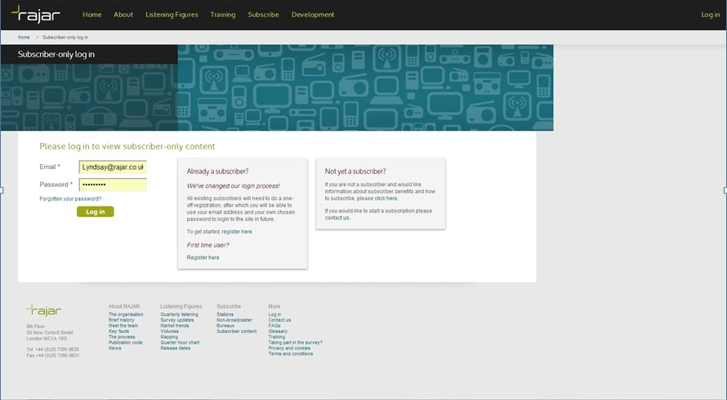
Log in
Please click ‘First Time user’ and enter your details and the 16 digit Subscription Key provided by RAJAR
A link will be emailed to you to confirm your registration.
If you have already registered simply log-in with email address and password.

Slide 3
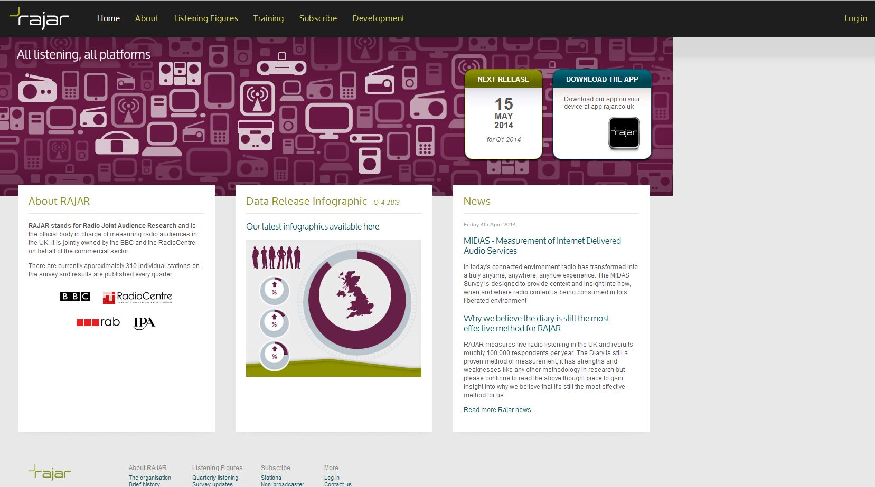
Home Page
The headings ‘About’, ‘Training’, ‘Subscribe’ and ‘Development’ are purely for reference and free for anyone to use.
The Subscriber only section mainly falls under the ‘Listening Figures’ section.

Slide 4
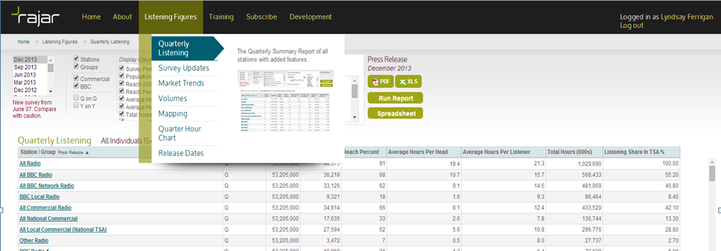
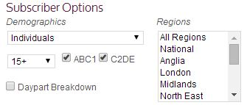
Listening Figures – Quarterly Listening
Top left hand corner select which Quarter (up to March 1999 available, make comparisons with caution). Please note more than one Quarter can be selected at one time by using the shift key.
Can select ‘Stations’ or ‘Groups’. Can filter BBC or Commercial only.
Once logged into the Subscriber section of the website the Quarterly Listening section has lots of different ways to look at the top-line results. A user has the ability to filter by certain demographics, age, social grade and regions. (see image)

Slide 5
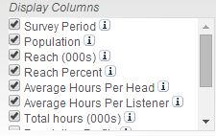
Listening Figures – Quarterly Listening
Left Click on Station or Group selected to view audience/day-part or audience/periods broken down by all demographics.
Any columns the user would like displayed can be ticked/unticked in the ‘Display Columns’ box (see back page glossary for descriptions of meaning and examples, or hover over the ‘i’ button)

Slide 6
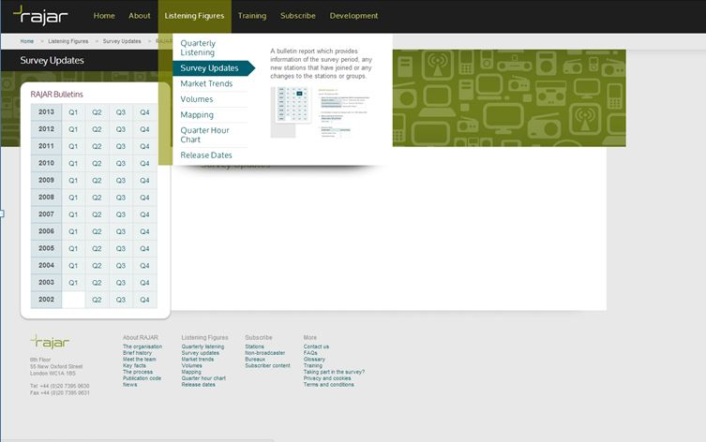
Listening Figures – Survey Updates
The Survey Updates are available to Non-Subscribers. This is a quarterly bulletin report provided to document any changes in the Survey.
For example new Stations or reporting, changes to reporting periods, TSA changes and Stations no longer reporting.

Slide 7
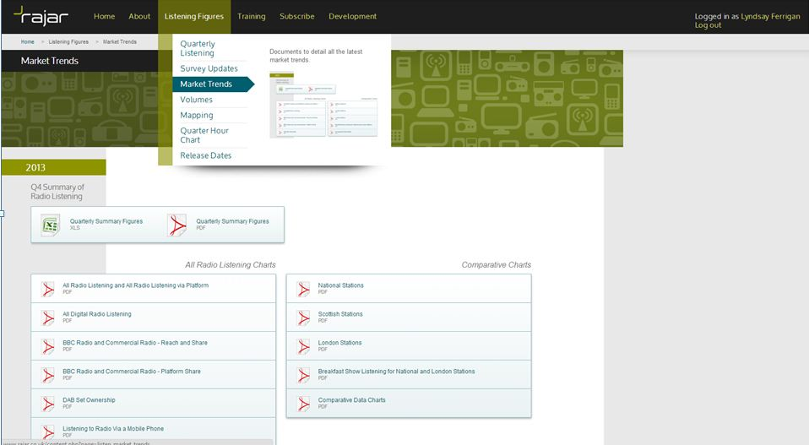
Listening Figures - Market Trends
Market Trends is also available for Non RAJAR Subscribers.
Included in this section is the Quarterly Summary (PDF and Excel versions).
All Radio Listening Charts including; All Radio Listening including share via platform, All Digital Radio listening, BBC Radio/Commercial Radio – weekly reach and share, BBC Radio/Commercial Radio – platform share, DAB set ownership, Listening to radio via a Mobile Phone.
Comparative Data Charts detailing radio listening figures for National, Scottish and London stations, as well as National and London stations’ Breakfast Shows including Year on Year and Quarter on Quarter comparisons.

Slide 8
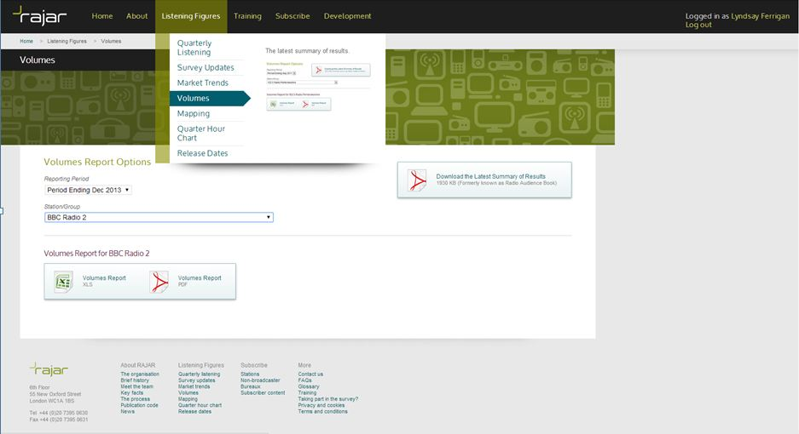
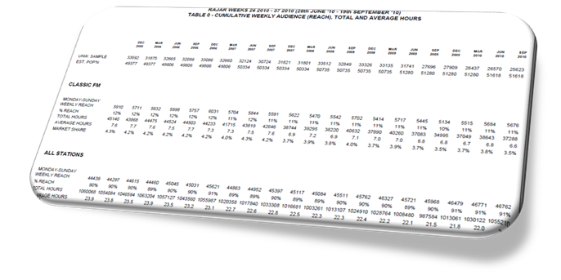
Listening Figures – Volumes Tables
Select Survey period and Station/Group
'Standard Results' (also known as 'Volume tables') for Commercial Stations and BBC National Stations/Networks. Aggregated data are tables published in a pre-set format, i.e. with pre-determined age brackets, time bands, etc. There are 10 pre-set tables for each Group/Station, below is the breakdown.
Table 0: Cumulative weekly audience Quarter on Quarter (All Adults)
Table 1: Cumulative weekly audience (reach), total and average hours (38 demographics)
Table 2: Share by day part segment (20 demographics)
Table 3: Reach by day part segment (20 demographics)
Table 4: Audience by half hour - Weekday average (20 demographics)
Table 5: Audience by half hour - Saturday (20 demographics)
Table 6: Audience by half hour - Sunday (20 demographics)
Table 7: Cumulative weekly audience (reach), total and average hours, by competitive stations
Table 8: Share by day part segment, by competitive stations
Table 9: Reach by day part segment, by competitive stations
Table 10: Predicted cumulative audiences (on 1 to 13 weeks, 20 demographics)

Slide 9
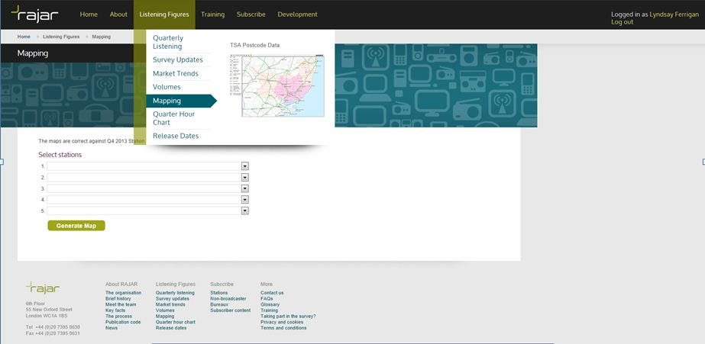
Listening Figures – Mapping
The Mapping tool can only be accessed if logged in as a Subscriber. The tool can only be accessed by using Internet Explorer as the browser.
Up to 5 Stations at a time can be selected. The TSA Maps are then generated and any overlaps highlighted. Overlays such as Towns, Cities, Roads, Postcode Sectors (hover over the postcode sector to display) can be selected and the Maps copied.

Slide 10
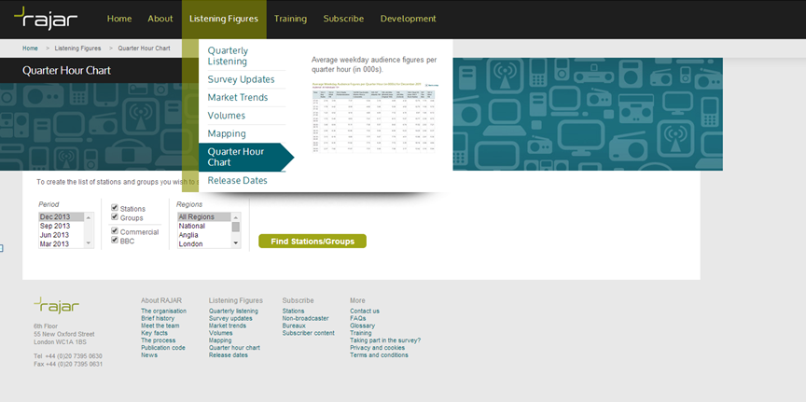
Listening Figures – Quarter Hour Chart
Average weekday and weekend audience figures per quarter hour in thousands. Filter the Quarter Hour Chart by Survey period, Regions, Station/Group, time period and demographic.
From selected information a user can either choose to run a report, enter the data into a spreadsheet or create a chart mapping the selected quarter hours.

Slide 11
Glossary
Survey Period
Q=Quarterly, H=Half Yearly, Y=Yearly. A Stations reporting period.
Population
the number of Adults 15+ who live in the named TSA
Weekly Reach
The number of people aged 15+ who tune to a radio station within at least 1 quarter-hour period over the course of a week. They must have listened for 5 minutes or more.
Weekly Reach %
The Weekly Reach expressed as a percentage of the Population within the TSA.
Average Hours per Head
The average length of time a person spends listening to a station. This is calculated by dividing the Weekly Hours by the Population.
Average Hours per Listener
The average length of time that listeners to a station spend with that station. This is calculated by dividing the Weekly Hours by the Weekly Reach.
Total Hours
The total number of hours that a station is listened to over the course of a week. This is the sum of all quarter-hours for all listeners.
Market Share % (or Listening Share %)
The percentage of all radio listening hours that a station accounts for within its transmission area. This can be calculated for any target market across any area.
Population Profile
Proportion of the target population in the TSA’s adult population.
Reach Index
The Weekly Reach % of a station against a Target Market indexed against the All Adult Weekly Reach % for that station. This indicates whether a Target Market is more or less likely to listen to a given station, with 100 being the norm.
Hours Index
The Average Hours for a station against a Target Market indexed against the All Adult Average Hours for that station. This indicates whether a Target Market is likely to listen to a given station for more or less time, with 100 being the normal figure.
Efficiency Factor
The Efficiency Factor indicates the all-time efficiency of a station at delivering a given Target Market. This is calculated by dividing the All Adult Weekly Hours by the Target Market Weekly Hours.

Slide 12
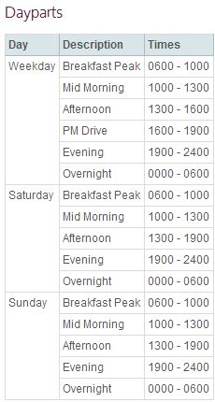
Day-part Times

